Slide 1
Online Plant Nursery
Group Members:
Shubham Palav (30)
Dinesh Shinde(42)
Vishal Singh(44)

Slide 2
INTRODUCTION
As our economy grows, more and more people are moving to cities from villages and small towns. The direct result of urbanisation is the mushrooming of concrete jungle in cities. This leads to less and less space for greenery and planting, which results in city-dwellers losing contact with nature.
That's why people living in cities are inclined to develop mini gardens or planting areas according to the space available in their house or offices. Moreover, people are now more aware of the benefits of greenery around them, which is another reason for them to consider planting.
So, by the utmost love for nature and having enthusiasm for gardening, we are starting an online plant nursery and help others fulfill their desire to be near plants and nature all the time.

Slide 3
PROBLEM STATEMENT
Many people who wants to buy plants directly go to the nearby nursery and buy the plants. However the problem is that most of them have some information about popular plant items and same goes for the sellers which is not good for expansion of the nursery business.
Customer does not compare plant price with other shopkeepers at the same time .In nursery there is no facility for online payment only cash may be consumed .we cannot purchase plants through online mode. The number of nurseries is not growing nowadays which limits it's reach.

Slide 4
AIM AND OBJECTIVES
To provide plants in online way.
To provide rare plants to plants lovers which are difficult
to find in their surrounding.
To expand the scope of plant nurseries by going online.
To provide information about plants in deep to the customers from beginning to end.
To make people aware of plants other than ordinary ones.

Slide 5
FEATURES
We will grow our own plants in a backyard nursery and also buy some plants wholesale for extra help.
Only owners/worker will be able to add, delete any products or update the website.
For shipping we will not only protect the plants from damage, but also keep them alive. Plants will be wrapped in a moist paper towel and then it will be wrapped by plastic and newspaper to keep them safe.
Door to door service will be provided. Payment mode is cash on delivery.

Slide 6
HARDWARE AND SOFTWARE
Front End :
HTML
CSS
JavaScript
Bootstrap
Back End
PHP
MYSQL
Website Hosting:
000webhost(Free Hosting)

Slide 7
CONSTRAINTS
There will be no instant gratification because the item will be shipped to the customers.
Shipping charges and delays can be common problems.
There will be a delivery risk.

Slide 8
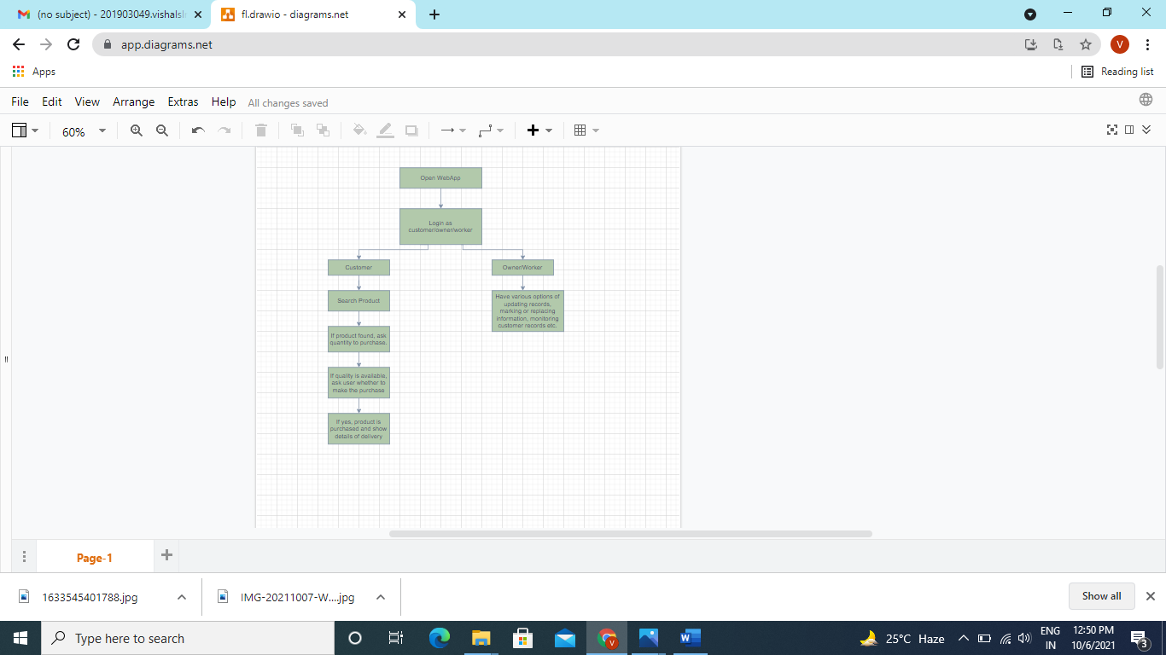
SYSTEM FLOWCHART

Slide 9
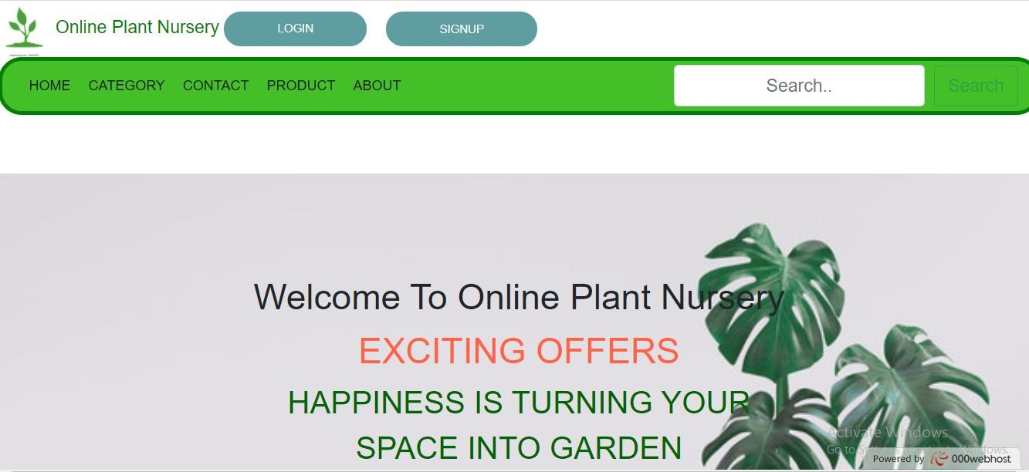
GUI OF WEBPAGES(home page)

Slide 10
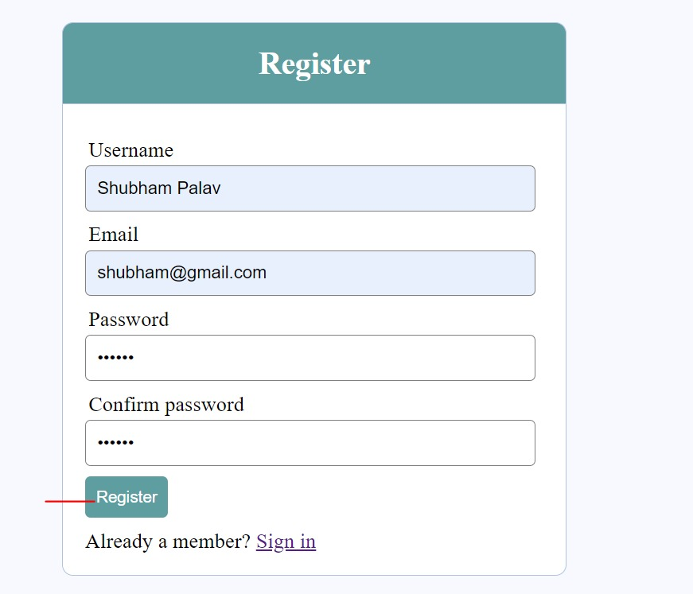
GUI OF WEBPAGES(register page)

Slide 11
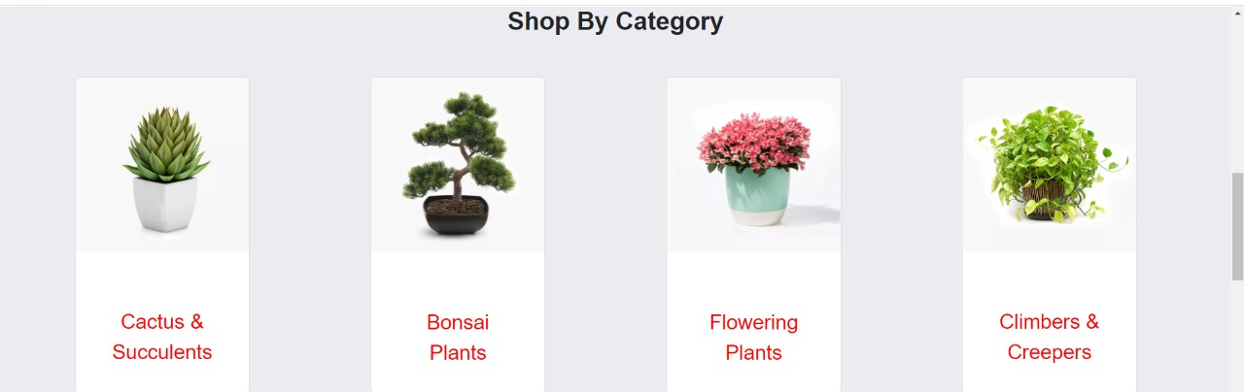
GUI OF WEBPAGES(categories)

Slide 12
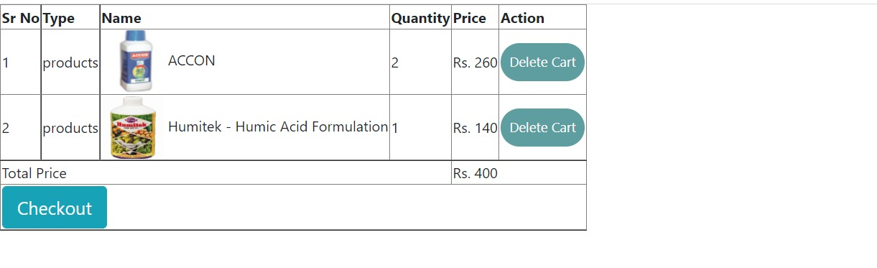
GUI OF WEBPAGES(cart)

Slide 13
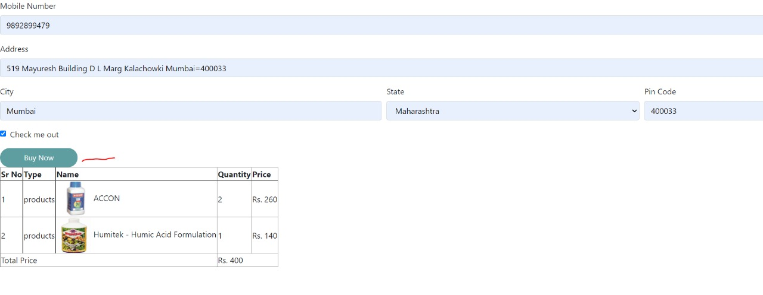
GUI OF WEBPAGES(buying page)

Slide 14
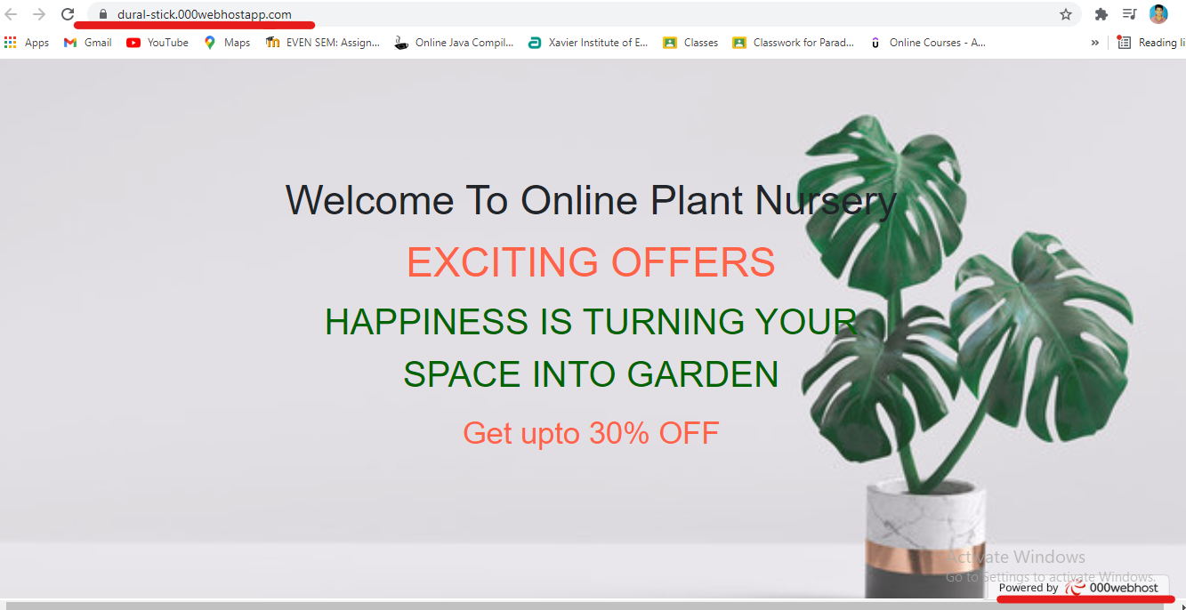
Hosted Website:

Slide 15
CONCLUSION
Our project is made in such a way that modification can be done easily.
It provides a friendly graphical user interface which proves to be better when compared to the existing system
Only authorized workers can edit the website.
Customers have to login for buying any product.
Payment can be made by cash on delivery.

Slide 16


